Slide 1


Body temperature
R_{c}²=0.30; Weight = -
Day = 0.4108; Day² = -0.5864
β=-0.0035 (N.S.)
(38.6˚C- 40.5˚C)
β=0.0122 (N.S.)
β=0.1647**
Activity
R_{c}²=0.41 Weight -
Day = -; Day² = -
Ambient temperature
r=0.0353 (N.S.)
(12.3˚C- 39.3˚C)
(0.1%- 24.1%)
β=0.0839***
β1=-0.0013
β2=0.1986*
ID 1 4 5 8 9 10 11 15 18 19 20
2019 9 66 64 0 32 76 12 92 9 66 39
2020 0 36 17 20 0 0 0 0 0 50 38
Heart rate
R_{c}²=0.67; Weight 0.6011
Day = -0.2770 Day² = -
Summer Day
(n=626)
(36.5- 95.2 bpm)
All data
Notes:
Model with daynr and daynr^2

Slide 2

Body temperature
R_{c}²=0.40; Weight = -
Day = -; Day² = -
β=-0.0379 (N.S.)
(38.4˚C- 39.5˚C)
β=-0.0648 (N.S.)
β1= 0.9079**
β2=-0.7635**
Ambient temperature
Activity
R_{c}²=0.35; Weight = -
Day = -0,5224-;Day² = 0.5100
r=0.0638 (N.S.)
(3.8˚C- 30˚C)
(0.0%- 21.8%)
β=0.0643 (N.S.)
β1=0.3507***
β2=-0.2529**
ID 1 2 4 5 9 10 11 15 18 19 20
n 3 9 71 18 32 49 10 91 6 4 5
Heart rate
R_{c}²=0.04; Weight -
Day = 0.5720; Day² = -
Fall Day
(n=298)
(40.1-85.0bpm)
Notes:
Model with daynr and daynr^2

Slide 3

Body temperature
R_{c}²=0.26; Weight = -
Day = -0.2293; Day² = -
β=0.0517 (N.S.)
β=-0.0017(N.S.)
β=-0.1431**
Activity
R_{c}²=0.33; Weight -
Day = -; Day² = -
Ambient temperature
r=0,1783***
(-0.7˚C- 21.2˚C)
β=0.0297 (N.S.)
β=0.099***
ID 4 5 8 9 10 15 18 19 20
win19-20 31 4 0 10 0 54 10 6 10
win18-19 36 29 4 7 44 86 6 31 9
Heart rate
R_{c}²=0.67; Weight -0.4334
Day = -1.093; Day² = 0.7058
Winter Day
(n=377)
Notes:
Model with daynr and daynr^2

Slide 4
Body temperature
R_{c}²=0.50; Weight = -
Day = -; Day² = 0.3379
β=-0.0022 (N.S.)
(38.5˚C- 39.9˚C)
β=-0.0049 (N.S.)
β=-0.0762*
Activity
R_{c}²=0.17; Weight -
Day = -; Day² = -
Ambient temperature
r=0.1482***
(2.8˚C- 29.6˚C)
(0.3%- 23.9%)
β=0.0652***
β=0.1244***
ID 1 2 4 5 8 9 10 15 16 18 19 20
spring2019 9 4 67 36 0 21 64 92 0 18 72 26
spring2020 0 7 36 16 9 15 0 0 6 65 66 17
Heart rate
R_{c}²=0.62; Weight -
Day = 0.5720; Day² = -
Spring Day
(n=646)
(29.0-87.6bpm)
Notes:
Model with daynr and daynr^2

Slide 5
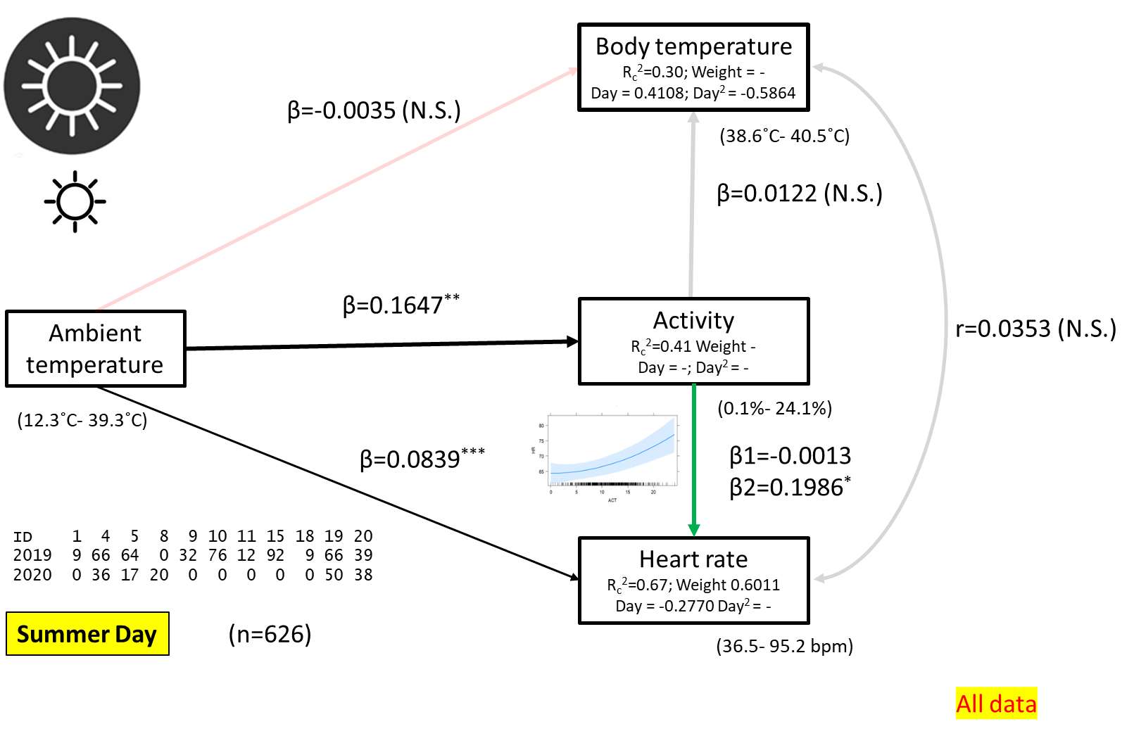
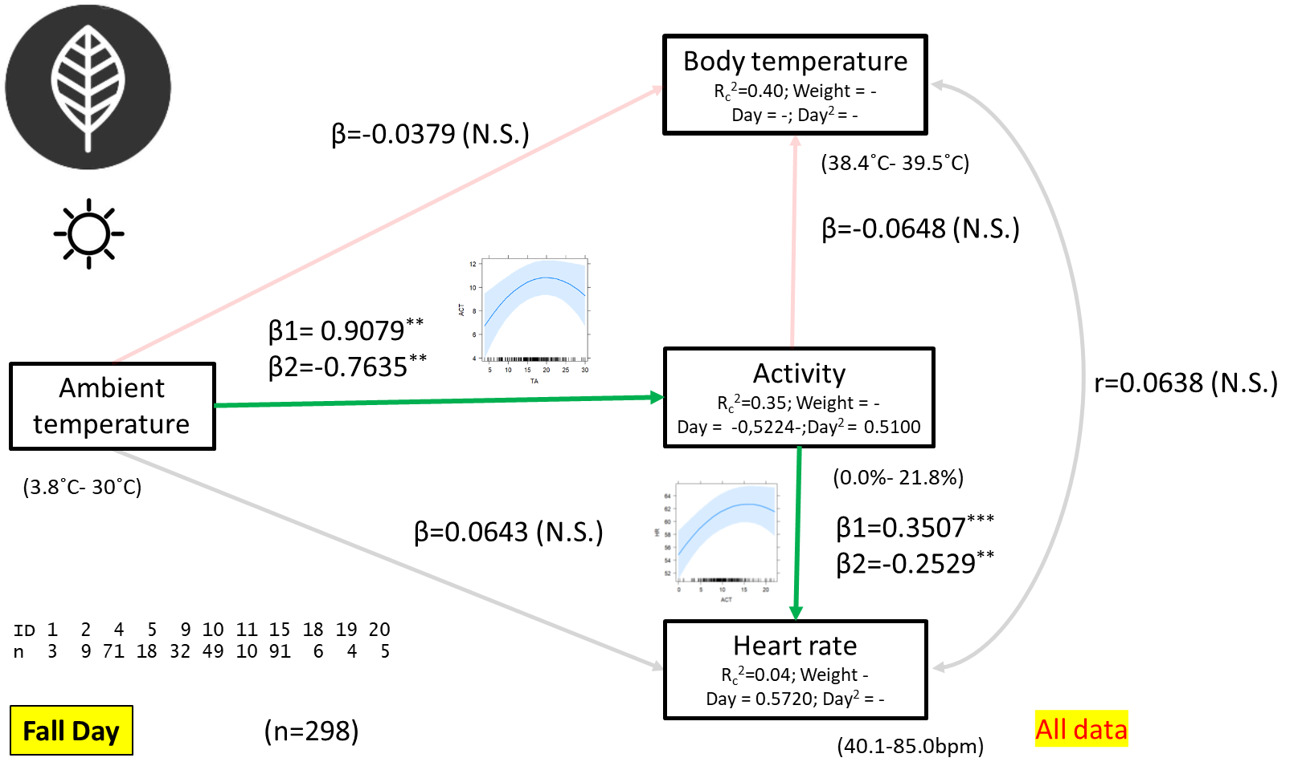
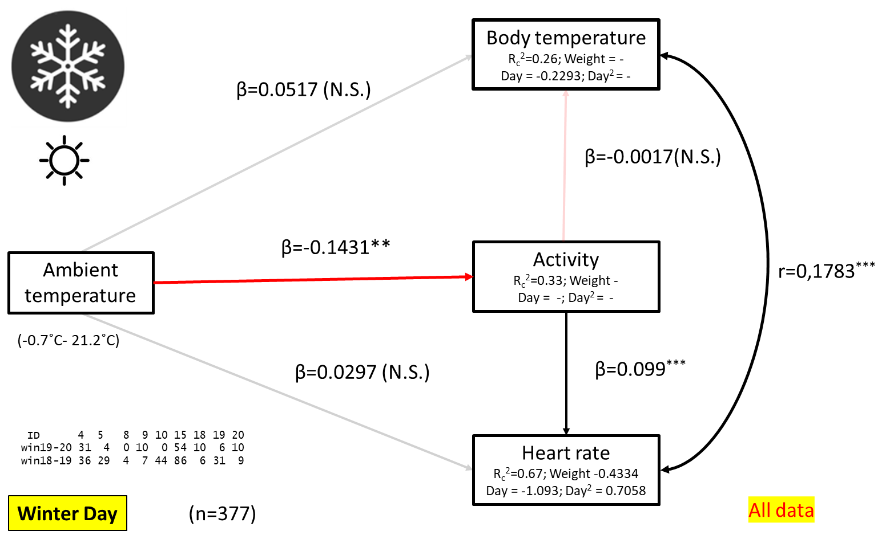
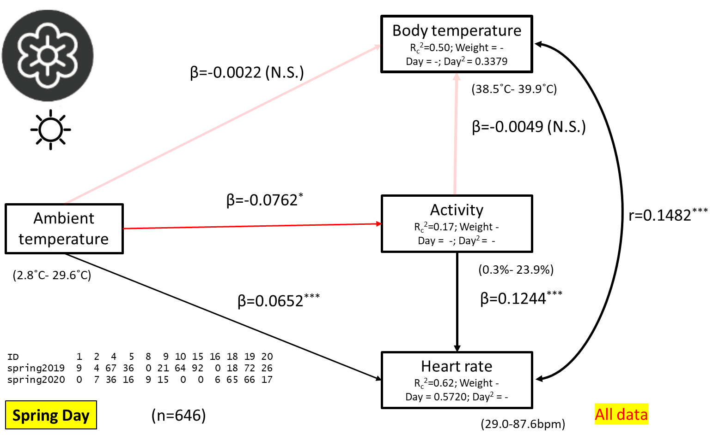

Slide 6

Body temperature
R_{c}²=0.30; Weight = -
Day = - ; Day² = -
(38.6˚C- 40.5˚C)
β1=0.7489**
β2=-0.7000**
β=-0.0845*
β=-0.0641 (N.S.)
Activity
R_{c}²=0.32 Weight = -
Day = -; Day² = -
Ambient temperature
r=-0.0059 (N.S.)
(9.2˚C- 27.5˚C)
(0.0%- 24.9%)
β=0.0213 (N.S.)
β1=0.3040***
β2=-0.1271*
ID 1 4 5 8 9 10 15 18 19 20
sum19 4 40 53 0 14 56 89 6 40 27
sum20 0 25 11 10 0 0 0 0 37 27
Heart rate
R_{c}²=0.64; Weight = 0.5352
Day = -0.3000; Day² = -
Summer Night
(n=439)
(36.9- 91.1 bpm)
All data
Notes:
Model with daynr and daynr^2

Slide 7
Body temperature
R_{c}²=0.52; Weight = -
Day = -; Day² = -
β= 0.2496***
(38.7˚C- 39.8˚C)
β=-0.0429 (N.S.)
β= -0.2958***
Ambient temperature
Activity
R_{c}²=0.18; Weight = -
Day = 0.4482-;Day² = -0.6712
r=-0.1264*
(-0.9˚C- 26.2˚C)
(0.0%- 23.2%)
β=0.0429(N.S.)
β1=0.2377***
β2=-0.1491*
ID 2 3 4 6 7 8 9 11 12 13
n 8 59 25 26 47 7 91 16 5 10
Heart rate
R_{c}²=0.02; Weight -
Day = -; Day² = -
Fall Night
(n=294)
(40.2-87.9 bpm)
Notes:
Model with daynr and daynr^2

Slide 8
Body temperature
R_{c}²=0.36; Weight = -
Day = -0.2013; Day² = -
β1=0.4065***
β2=-0.2298*
(38.5˚C- 40.4˚C)
β=-0.0706*
β=-0.0636 (N.S.)
Activity
R_{c}²=0.50; Weight -
Day = -; Day² = -
Ambient temperature
r=0.1681***
(-4.8˚C- 17.5˚C)
(0%-25%)
β=0.0436**
β=0.1245***
ID 4 5 8 9 10 15 18 19 20
win18-19 50 35 4 5 48 88 11 30 15
win19-20 34 15 4 8 0 55 33 5 17
Heart rate
R_{c}²=0.83; Weight - Day = -0.682; Day² = 0.2974
Winter Night
(n=457)
(22.0 – 86.0 bpm)
Notes:
Model with daynr and daynr^2

Slide 9
Body temperature
R_{c}²=0.53; Weight = -
Day = -; Day² = 0.2954
β=0.0556 (N.S.)
(38.6˚C- 40.2˚C)
β=-0.0767**
β=0.0061 (N.S.)
Activity
R_{c}²=0.23; Weight -
Day = -; Day² = -
Ambient temperature
r=0.1270**
β1=0.2269***
β2=-0.1721*
(0.2˚C- 23.7˚C)
(0.0%- 24.3%)
β=0.1323***
ID 1 2 4 5 8 9 10 15 18 19 20
spring2019 5 2 50 37 3 18 60 90 12 68 21
spring2020 2 7 23 15 4 9 0 0 50 62 9
Heart rate
R_{c}²=0.78; Weight -
Day = 0.5814; Day² = -
Spring Night
(n=547)
(27.1-82.2 bpm)
Notes:
Model with daynr and daynr^2

Slide 10
